Slide 1
ACKNOWLEDGEMENT
We would like to express our sincere gratitude to our Computer Science professor Mrs. Nidhi Chauhan for letting us take upon this project and providing us with valuable guidance throughout our project – THE GAME OF DAYS. We would also like to thank my friends and family for their endless support without which we could not have completed this work on time.

Slide 2

INDEX
|
|
|
|
|
|
|
|
|
|
|
|
|
|
|
|
|
|
|
S.NO.
CONTENT
Slide NO.
( 1 )
( 2 )
( 3 )
( 4 )
( 5 )
About the Project Algorithms and Explanations Code
Sample Outputs Contributions and References
04
05
09
10
14
|
|
|

Slide 3





About ➔ The game of days
This is a project we made involving the days of the
year
One of the options helps us to print the calendar of a desired month of the specified year.
While another helps us to find out the day on any
specified date.

Slide 4


Brief explanation: -
For the generating the calendar, we take the reference of Gregorian calendar as its 1st January is Monday.
January has 31 = 7 × 4 + 3 days, so 1 February (7*4) will fall on the day which follows three days after 1 January . Similarly, 1 March (7*4+3) will fall on the day three days after the day corresponding to January 1, April 1 will fall 6 days after, and so on.
Thus, the first days of each month are offset with respect to 1 January by the array
{0, 3, 3, 6, 1, 4, 6, 2, 5, 0, 3, 5}.
After this array the calculation would be like that: -
int days (int y, int m, int d)
{
static int t [] = {0, 3, 3, 6, 1, 4, 6, 2, 5, 0, 3, 5};
return (y + t[m-1] + d) % 7;
}
Where, d is the day of the given month(m) and y is the difference of the given year with the Gregorian year which is same as the input year.

Slide 5
But this calculation is incomplete as there is no contribution of the leap year.
In a simple year there are 365(7*52 + 1) days and this one day will change
the day of the particular date
for example: if the day of 14th July, 2015 is Monday then there will be Tuesday on 14th July, 2016 and we have to find these extra number of days which is equal to the difference of the given year with the reference year
But, if we see a leap year there are 366(7*52 + 2) days and they will add
up an extra day after every 4 years.
So, we have to find the number of leap days also.

Slide 6
For this, we have to do a calculation which is:
y/4 – y/100 + y/400
And this calculation will add up number of leap day in the difference of the given year in the reference year
(as the y/4 will give the number of leap years from the reference year to the given year but it will add up the non-leap years of century also so we have to subtract y/100 and this action we eliminate the leap years which are divisible by 400 so we have to add y/400)
In a leap the extra will add up after the month of February so to perform the same algorithm of the month of the February and January we will subtract 1 from the given year (y -= m < 3) but We are subtracting 1 from the year for January and February for non-leap years too.
This means that there would be a "blank" day between February 28 and March 1, that
is, we have made every non-leap year a leap year, and leap years double-leap years.

Slide 7


If we subtract 1 from the t [] values of every month after February, that
would fill the gap, and the leap year problem is solved.
That is, we need to make the following changes:
t [] now becomes {0, 3, 2, 5, 0, 3, 5, 1, 4, 6, 2, 4}
So our full solution would be:
int days (int y, int m, int d)
{
static int t [] = {0, 3, 2, 5, 0, 3, 5, 1, 4, 6, 2, 4};
y -= m < 3;
return (y + y/4 - y/100 + y/400 + t[m-1] + d) % 7;
}
DAY CODE 0
1
2
3
4
5
6
DAY SUNDAY MONDAY TUESDAY WEDNESDAY THURSDAY FRIDAY SATURDAY

Slide 8


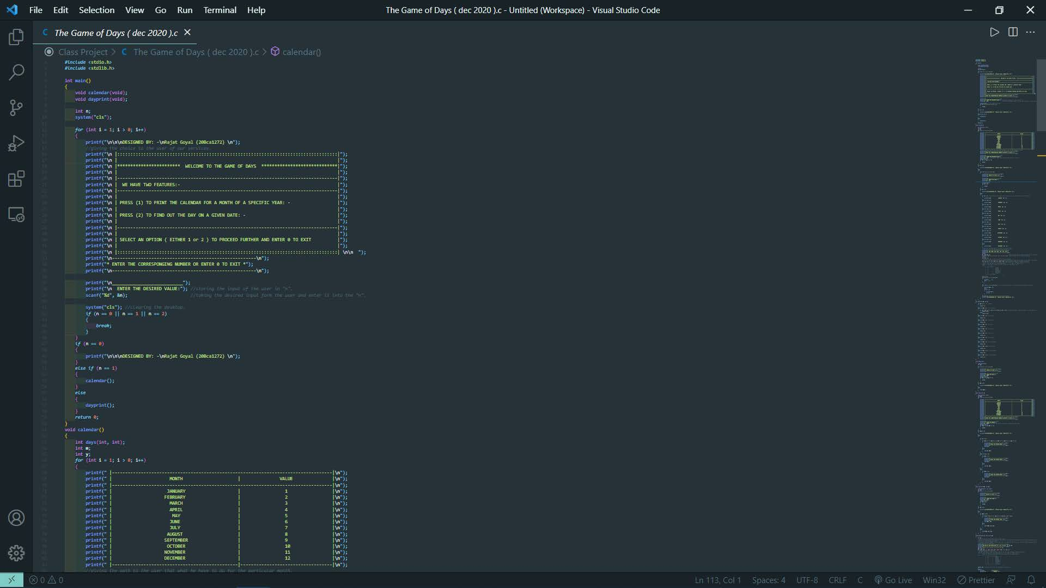
CODE :-

Slide 9
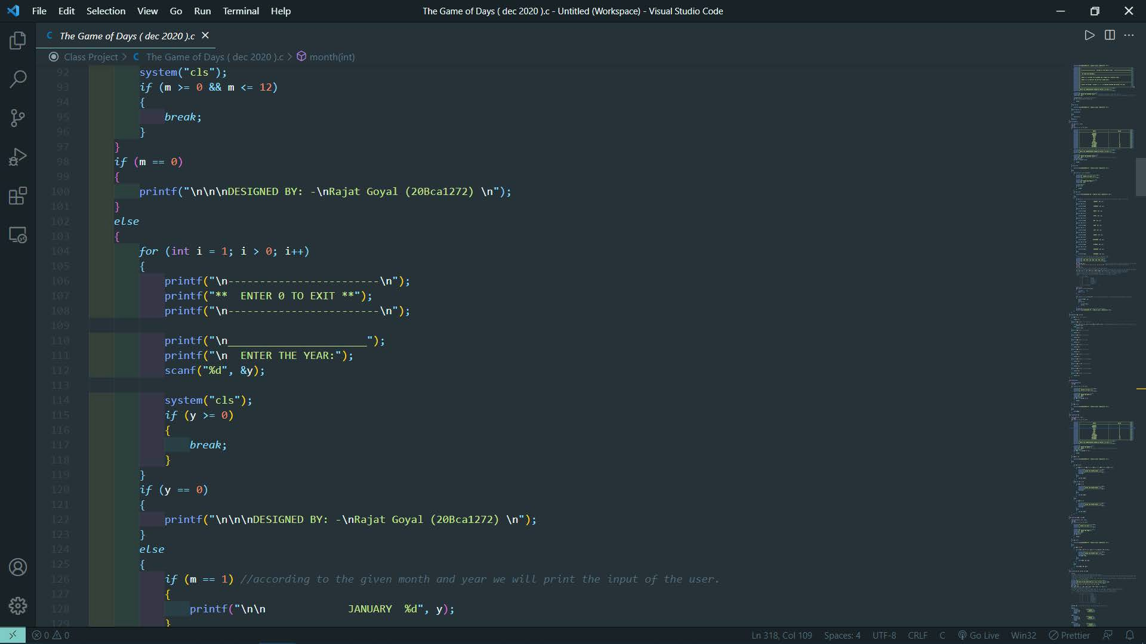

Slide 10
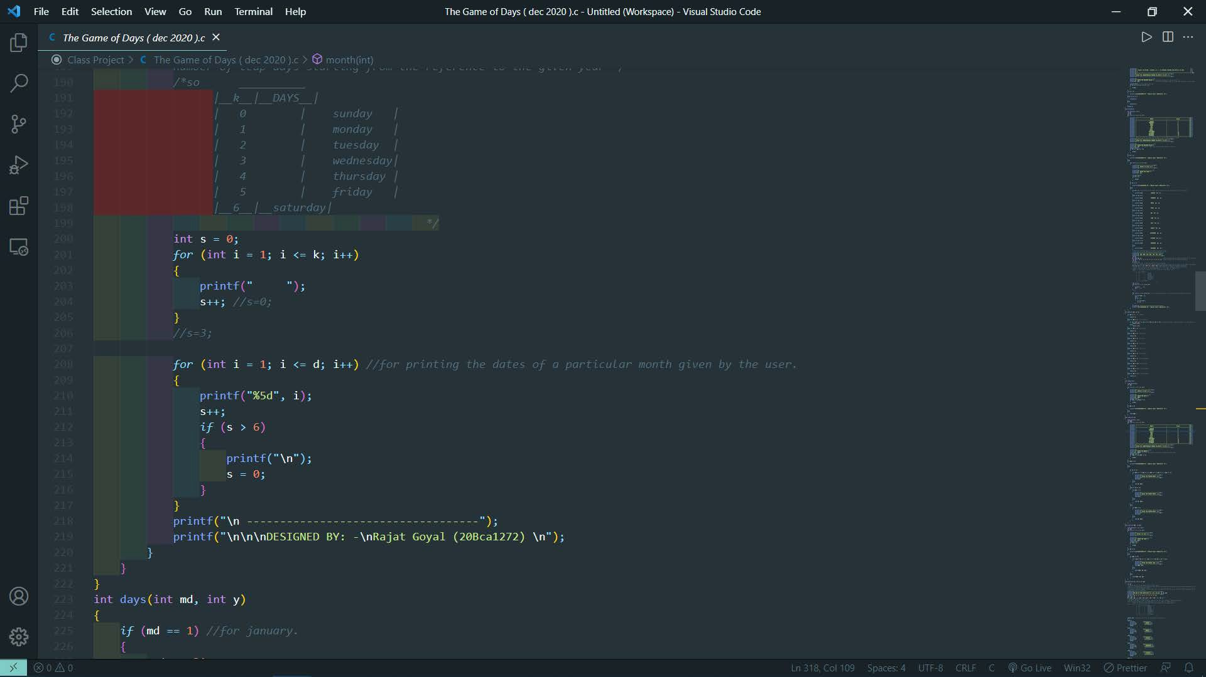

Slide 11
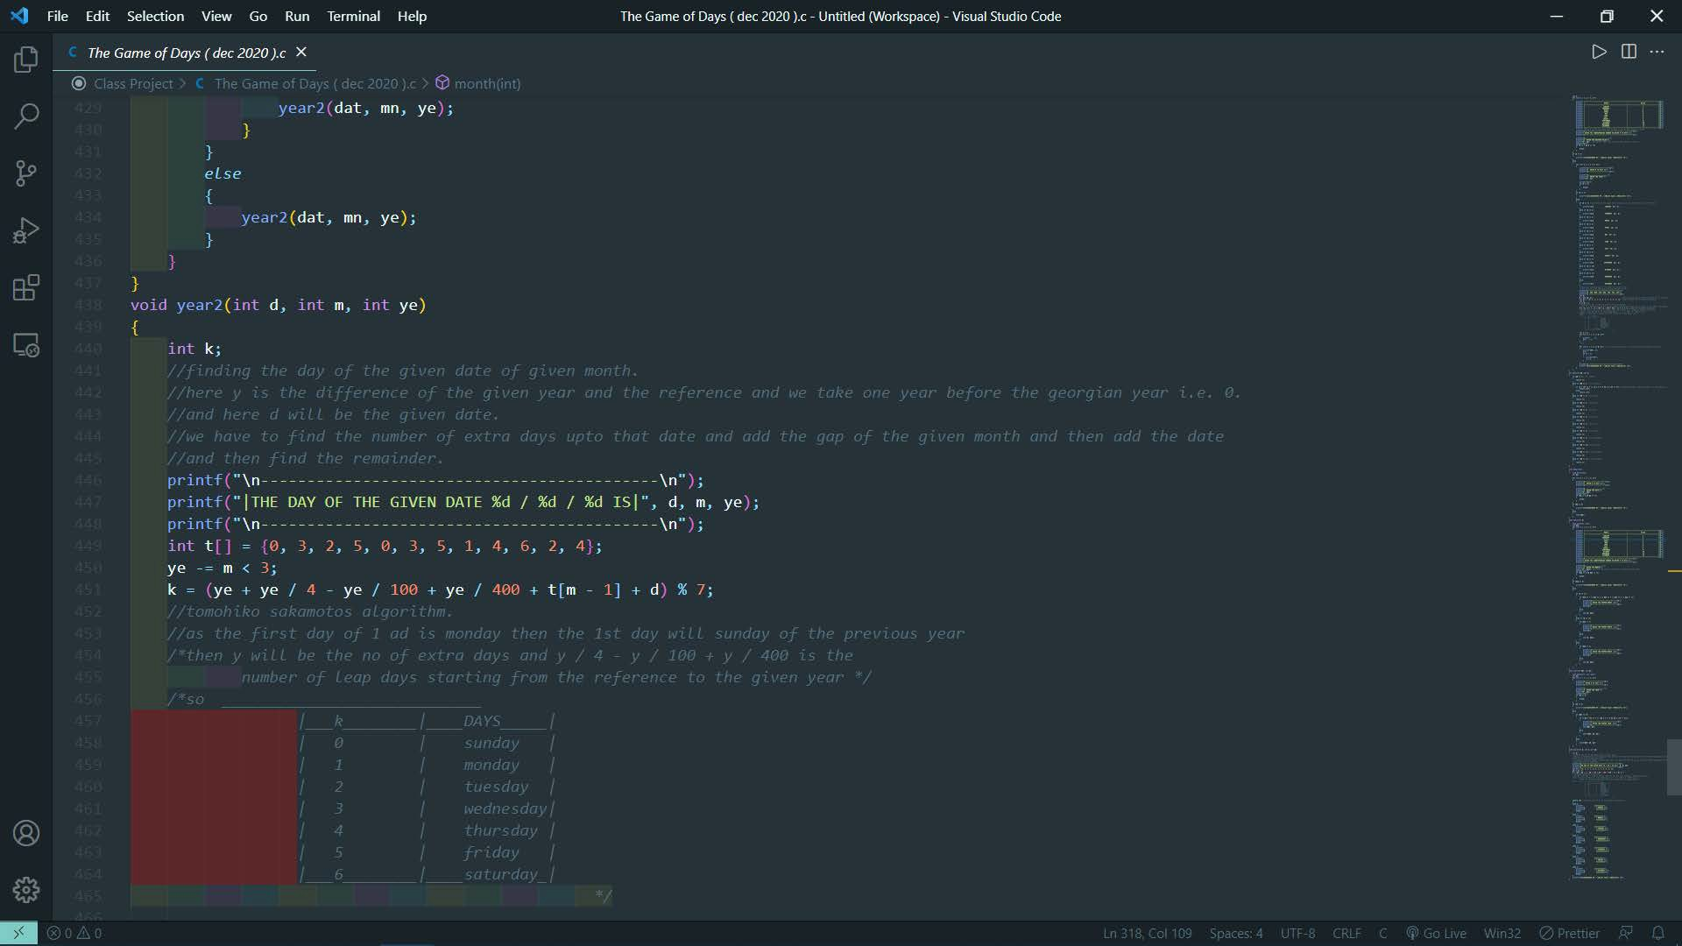

Slide 12
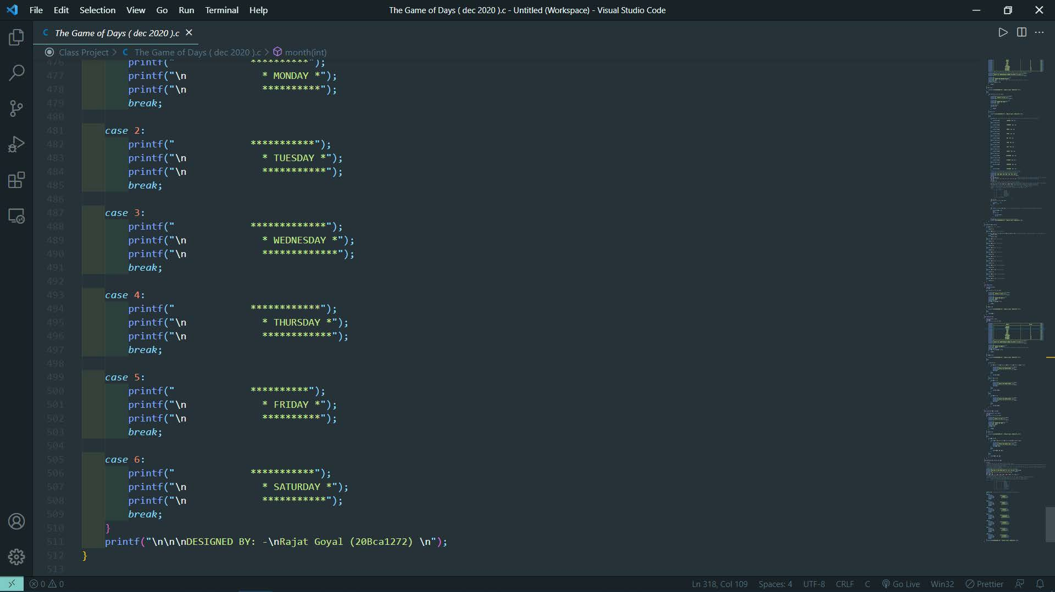

Slide 13
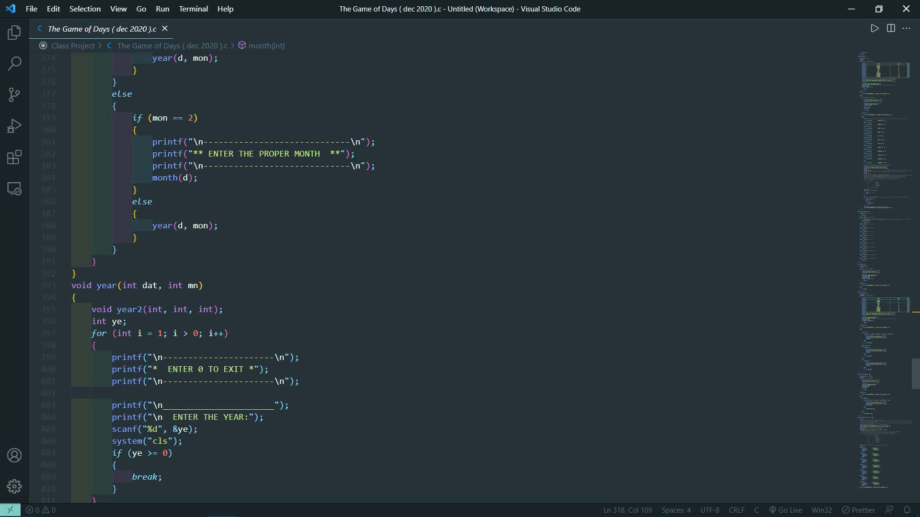

Slide 14
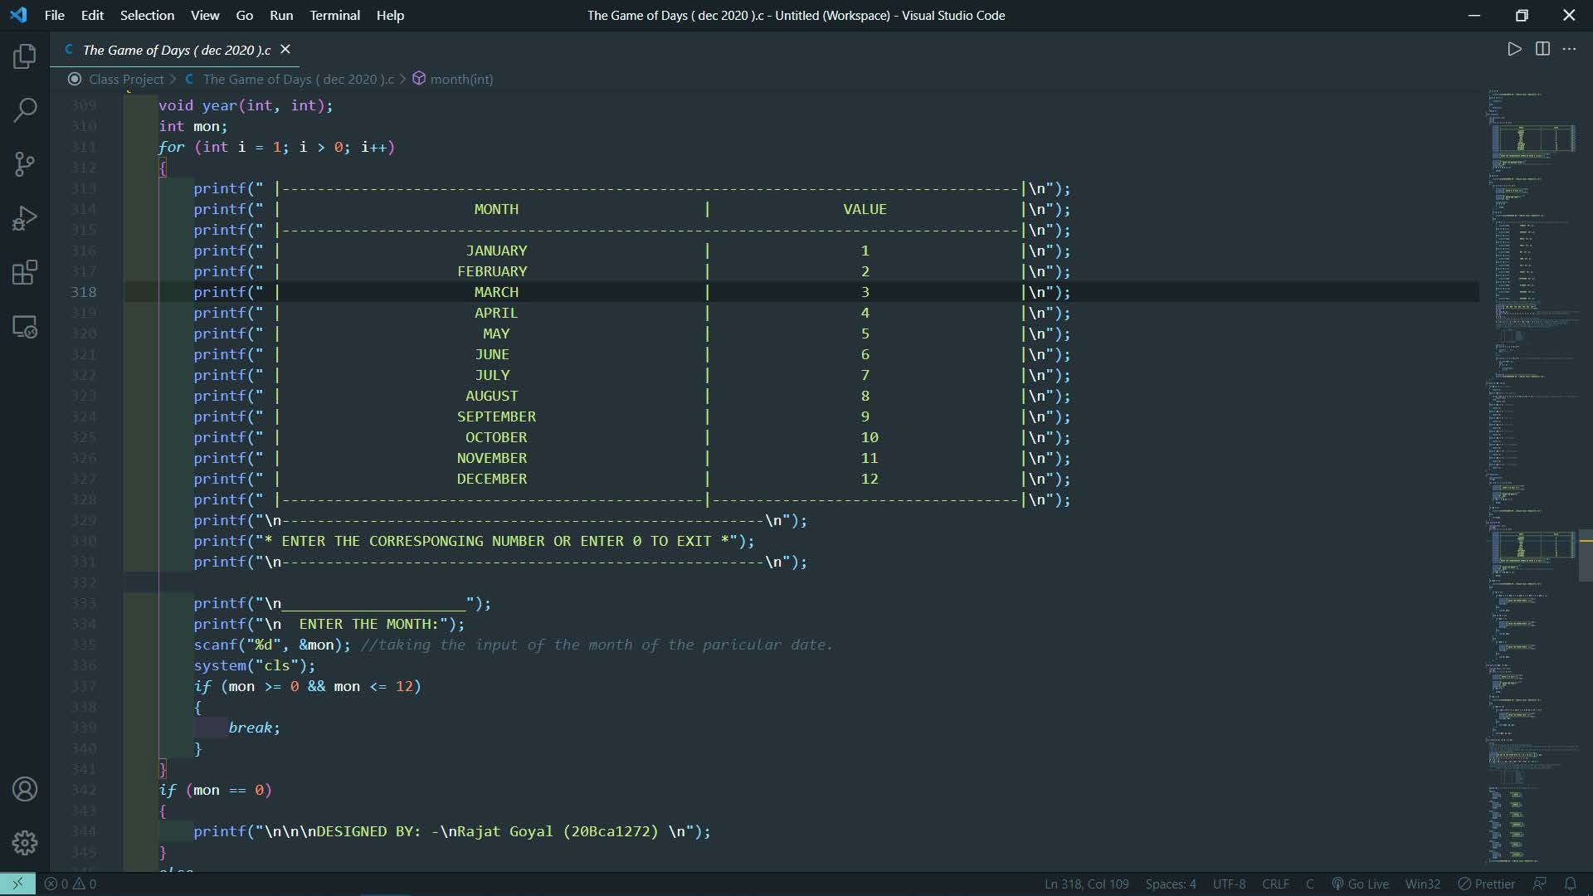

Slide 15
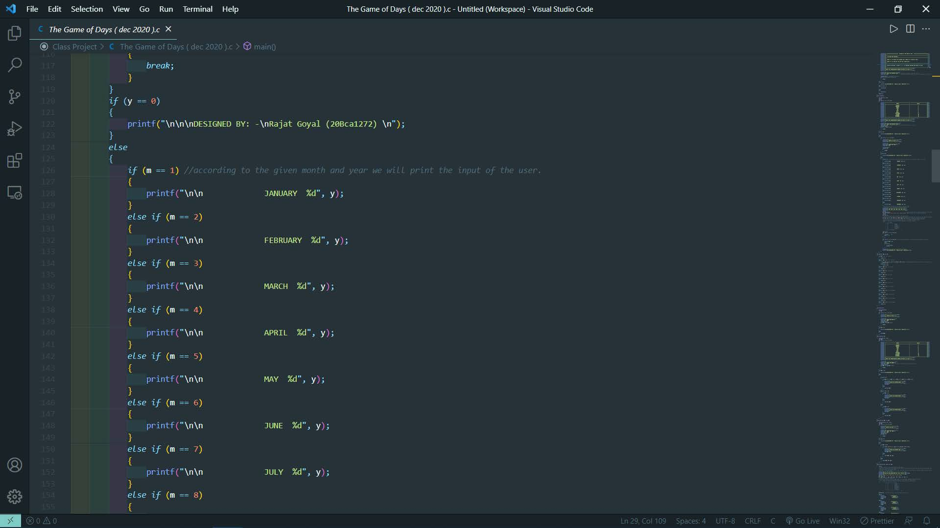

Slide 16
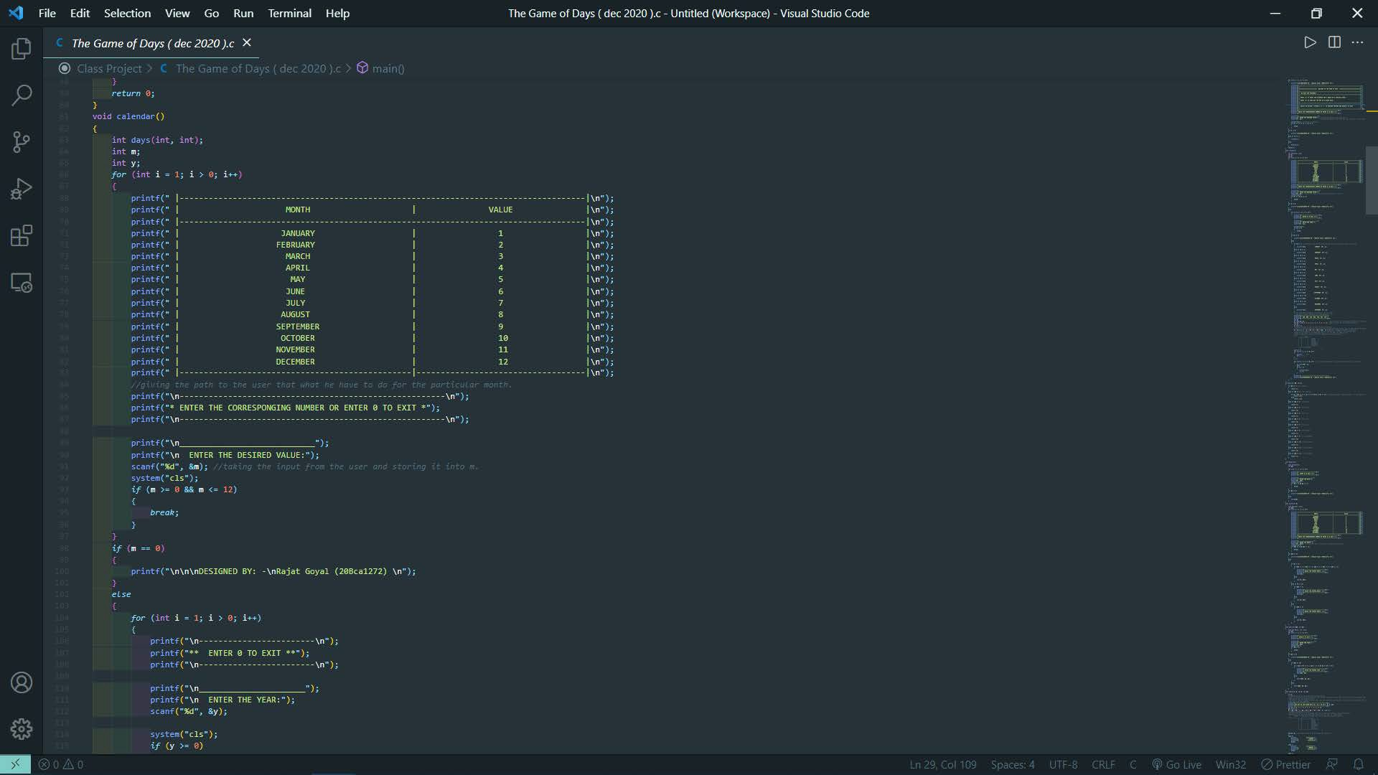

Slide 17
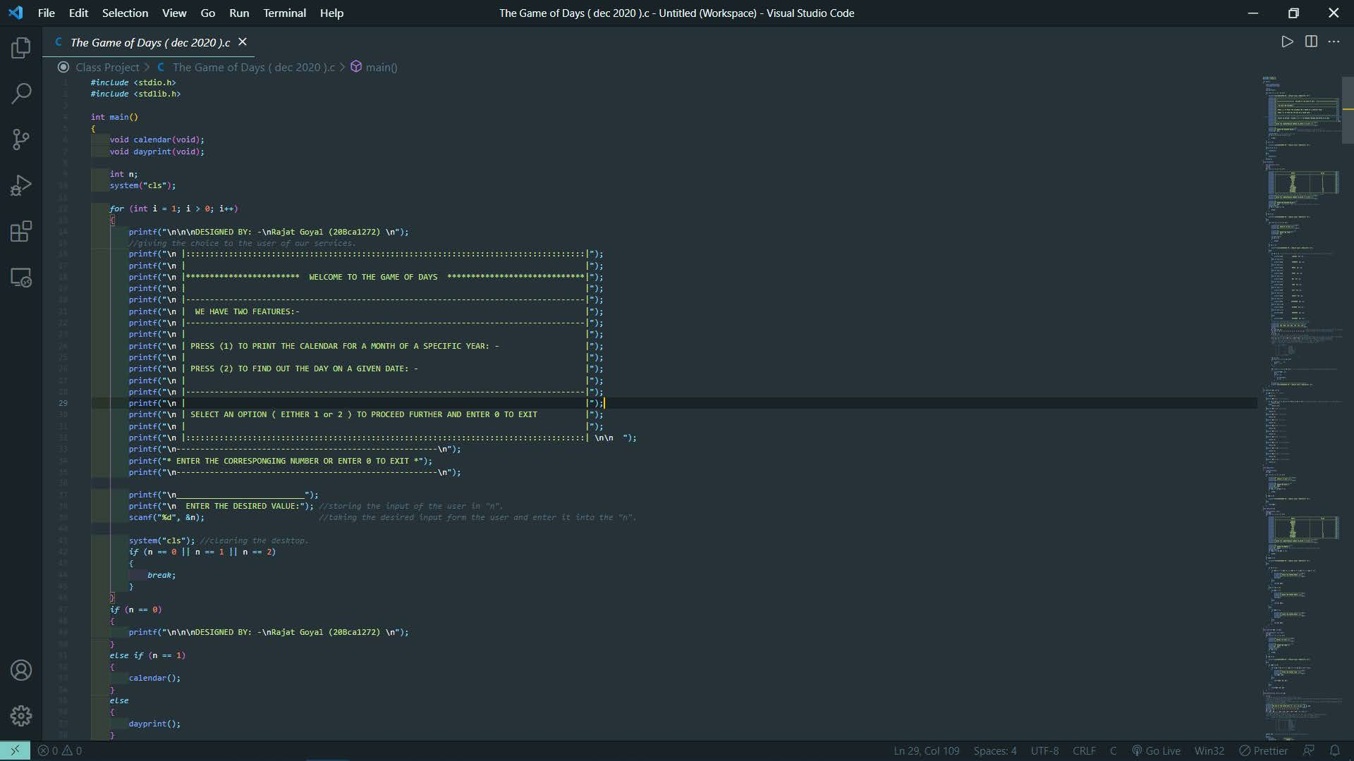

Slide 18
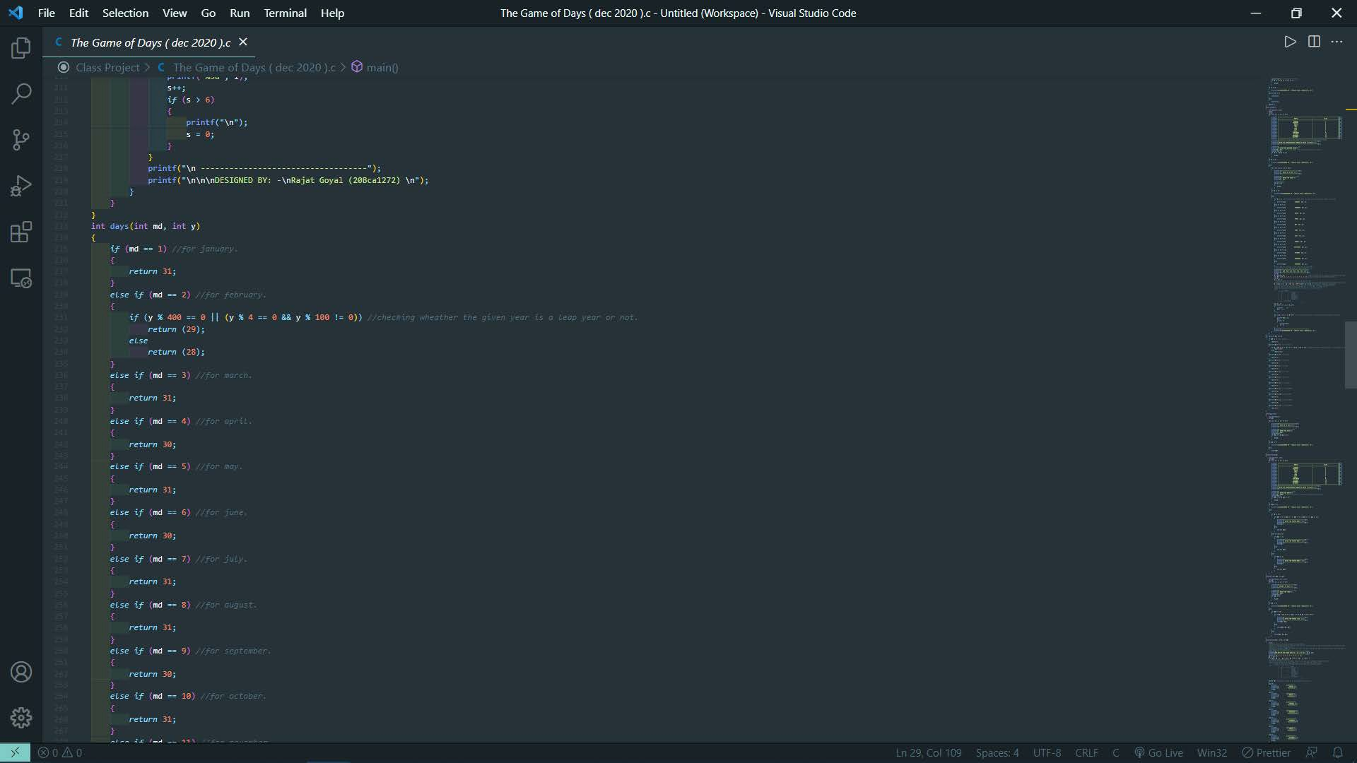

Slide 19


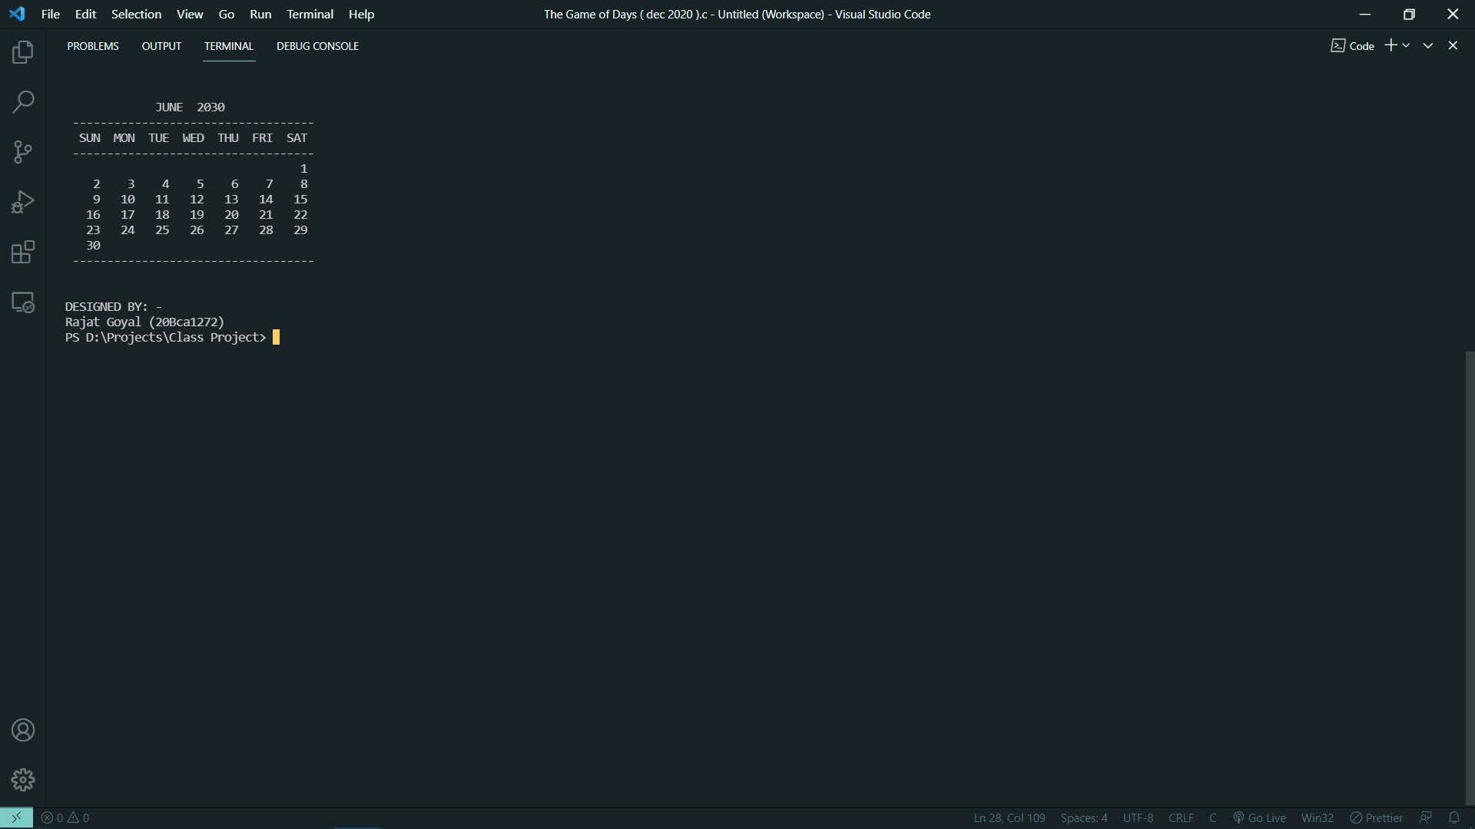
Sample Outputs :-

Slide 20
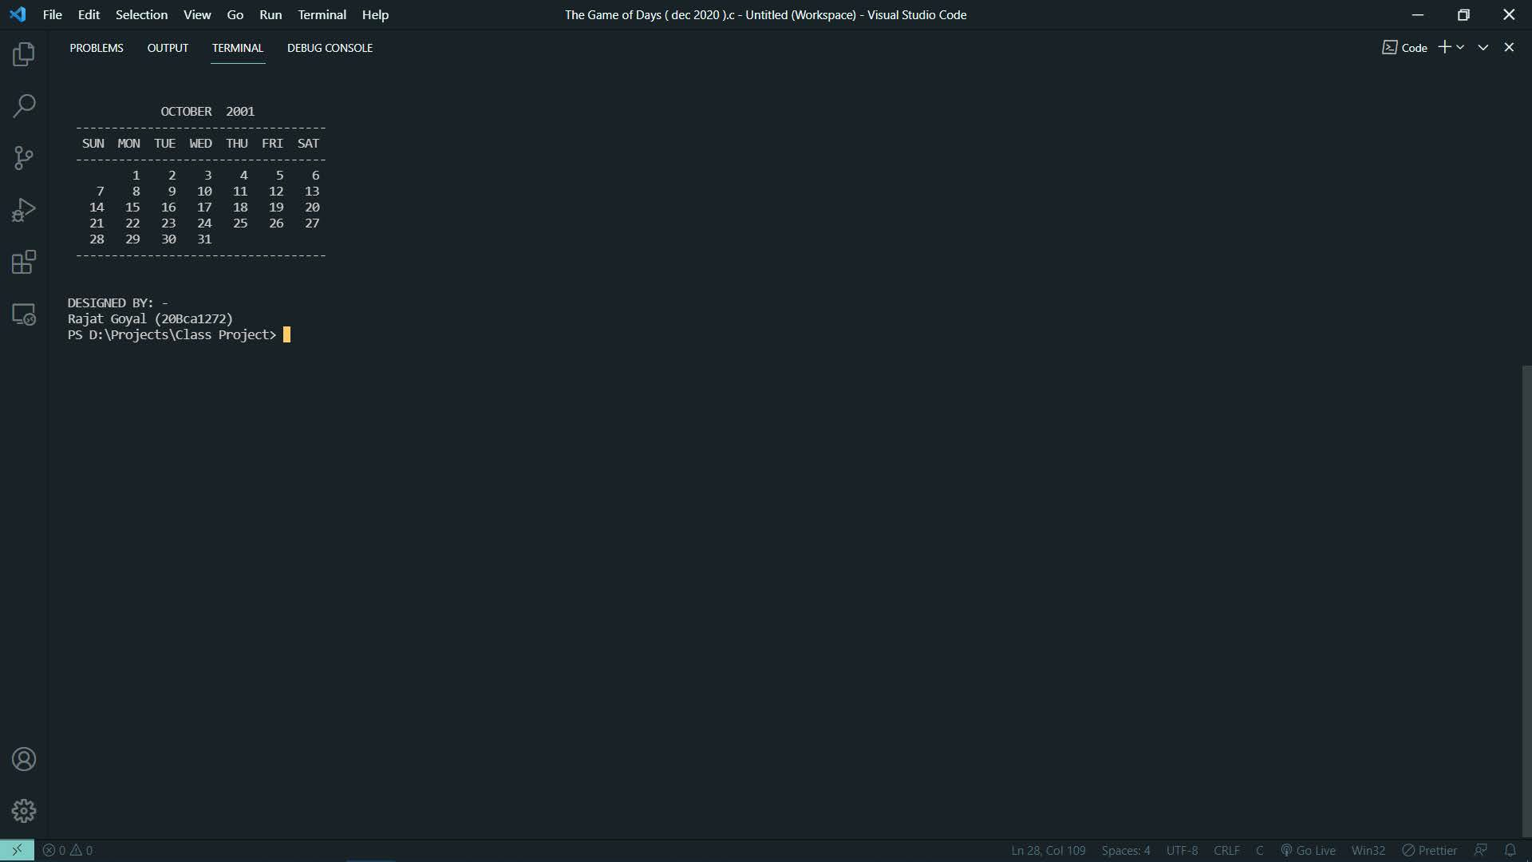

Slide 21
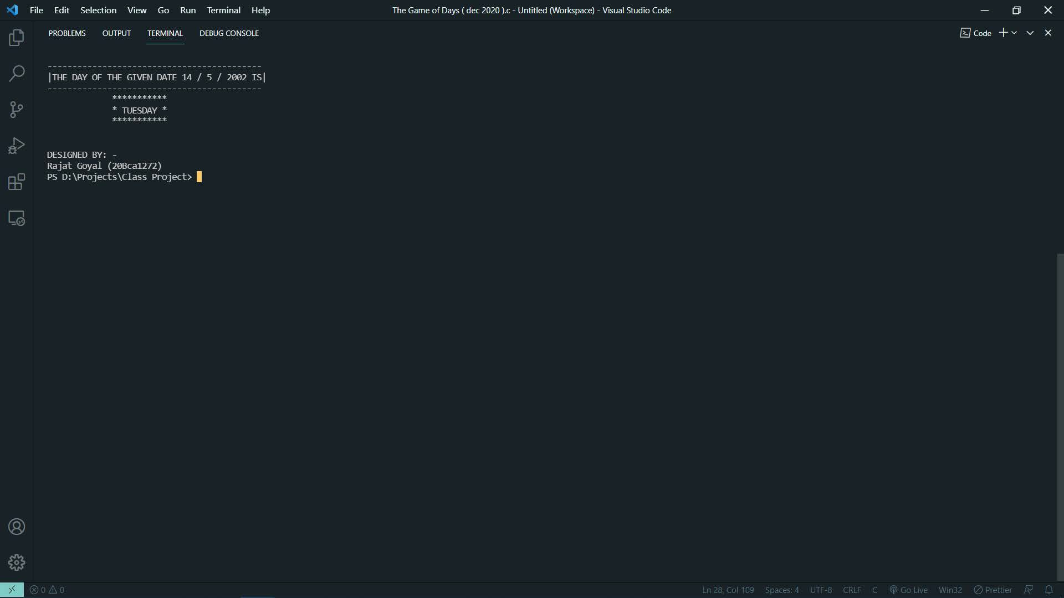

Slide 22
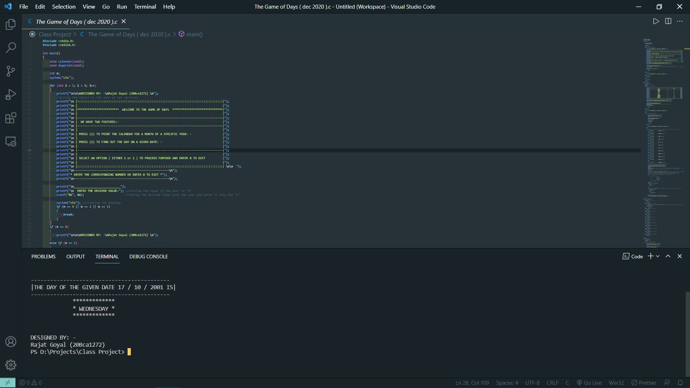

Slide 23
Contributions and References :-
This code has been build up from the logic related to repeating dates, months and years (including cases for leap years) in continuation with the pattern of the Gregorian Calendar.
From our pre requisite knowledge, we were able to build up this code for the year 2001-2030.
But to extend it even further, including the years before and after this, we took help of
the “ TOMOHIKO SAKAMOTOS ALGORITHM “ .
References from the internet have been taken from websites :
➔ Geeks for geeks
➔ Quora

Slide 24




Both members have equally contributed for the success of this code which involved building the logic, deciding the order, implementing procedures and statements, beautifying the code for better readability, modifying the screen for proper display of the output and finally, in compiling it all and creating this presentation.
GROUP MEMBERS :
(1). 20BCA1272 - Rajat Goyal (2). 20BCA1295 -Kritika Sejwal
So, at last, we would like to express our gratitude for letting us have an opportunity to work upon this topic.
-----The End-----

